Slide 1

Resilience in a sunburned (or flooded) country: navigating agriculture and pasture challenges in Australia
September 29th 2023 |INRAe

Slide 2

I would like to acknowledge the Kaurna people as the Traditional Owners and Custodians of the land, and pay my respect to their Elders past and present.
Notes:
Source: https://my.csiro.au/OrgInfo/Structure/Support/Indigenous/Resources

Slide 3

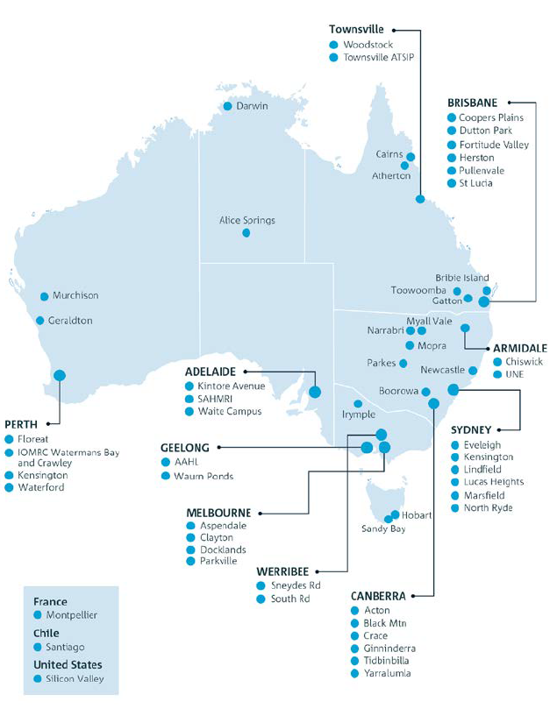
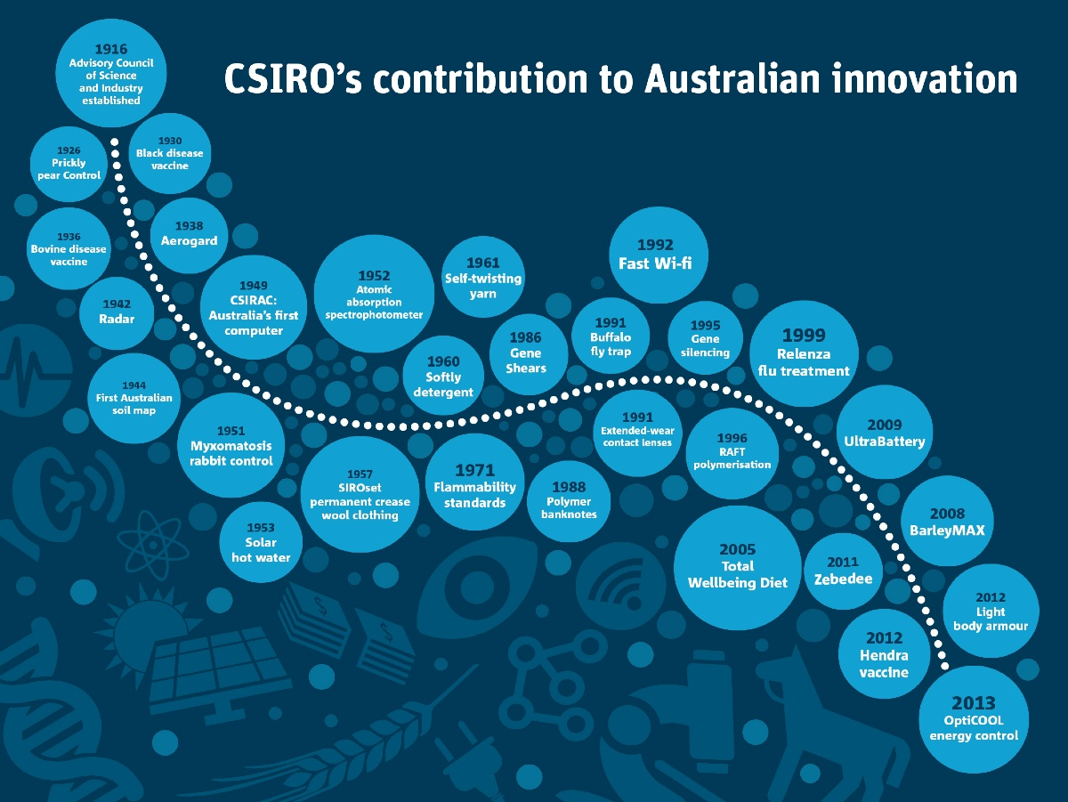
CSIRO

Slide 4
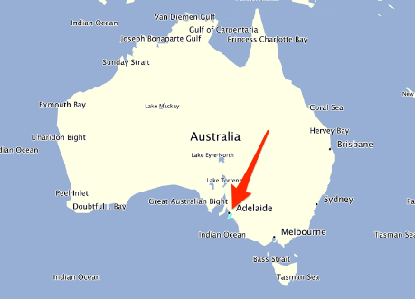

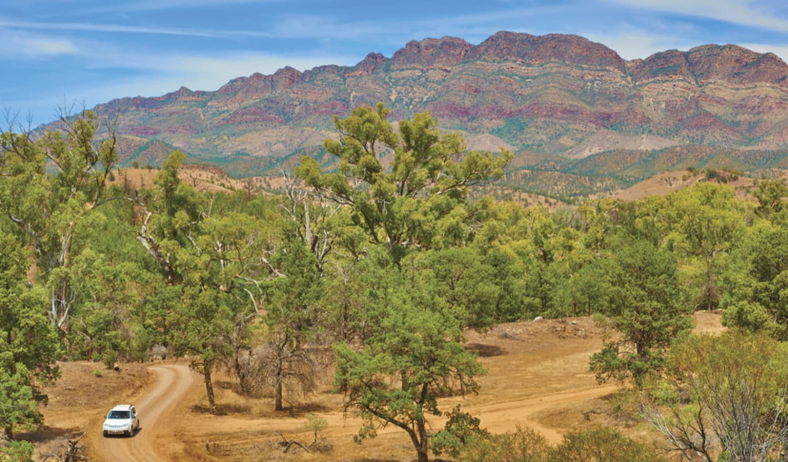
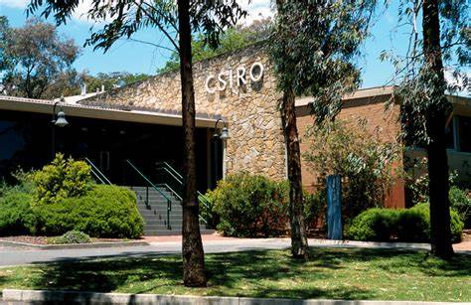
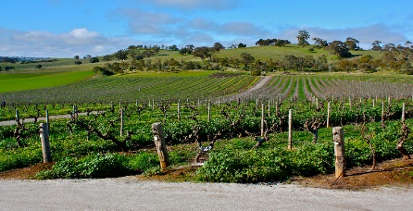
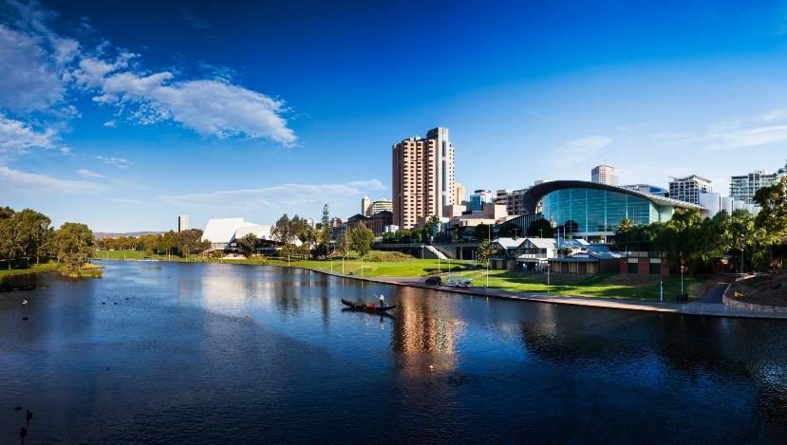
Adelaide

Slide 5
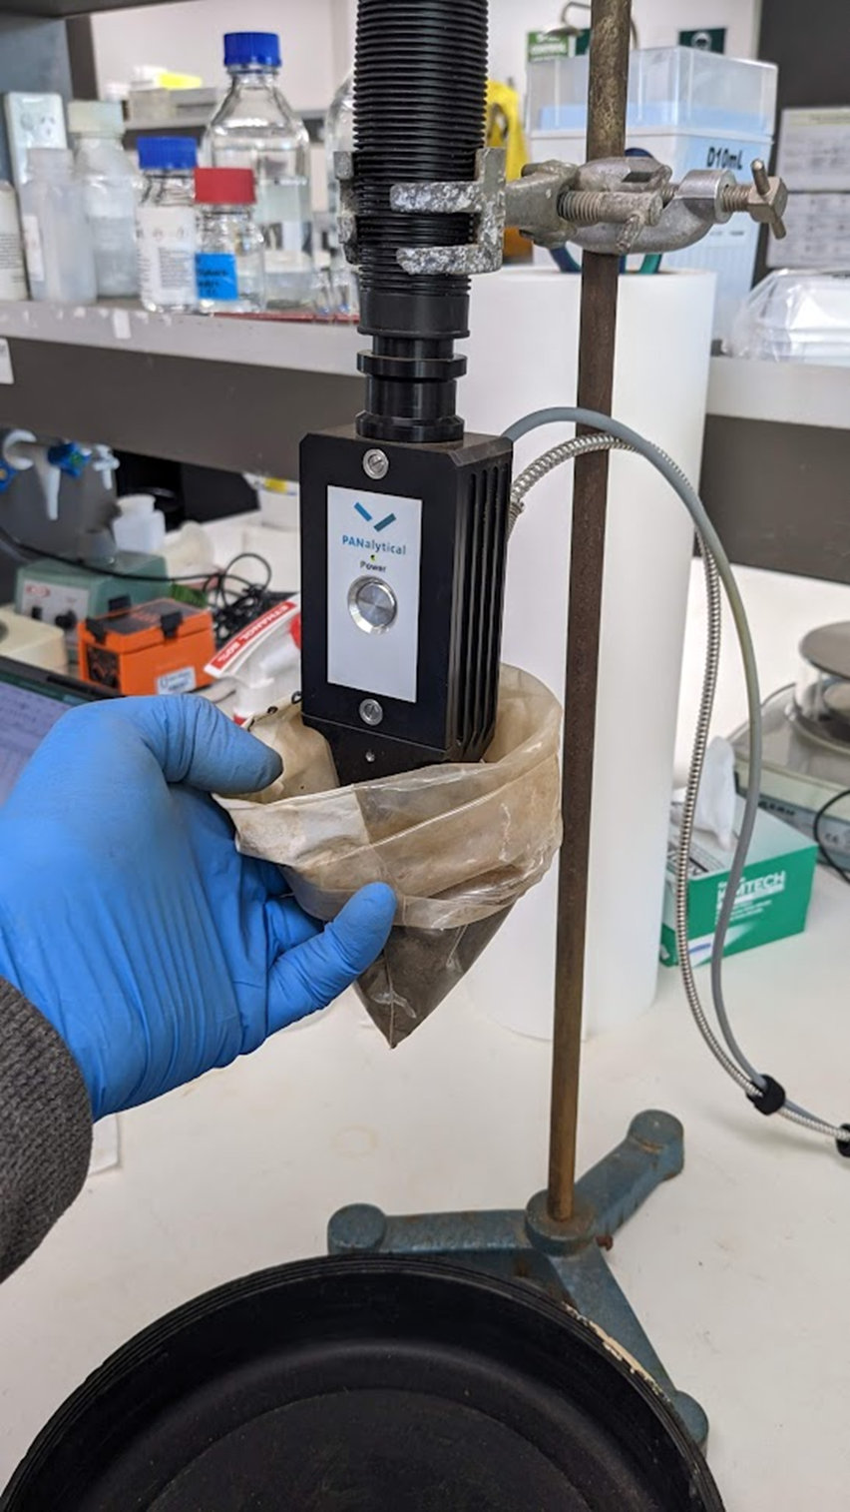
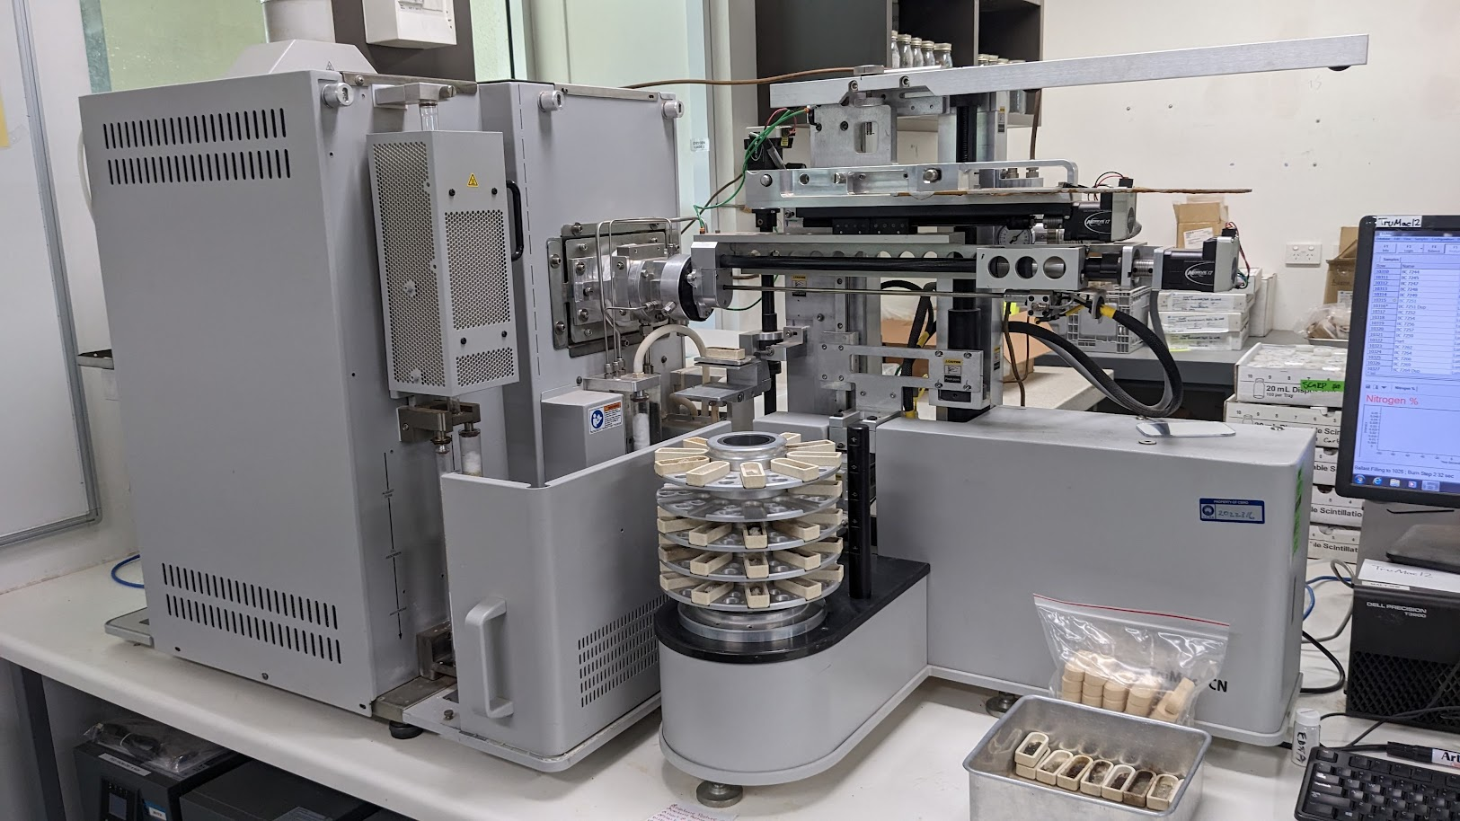
Overview of CSIRO’s soil carbon research
Work across
Different stakeholders
      Australia Government – ERF soil methodologies, National Greenhouse Gas modelling framework / FullCAM model development (with CSIRO L&W)
      Soil carbon aggregators
      Developing nations through DFAT/ACIAR
Different spatial and temporal supports
      Paddock to Continental scales
Mechanisms
Measurement
Modelling
Policies

Slide 6
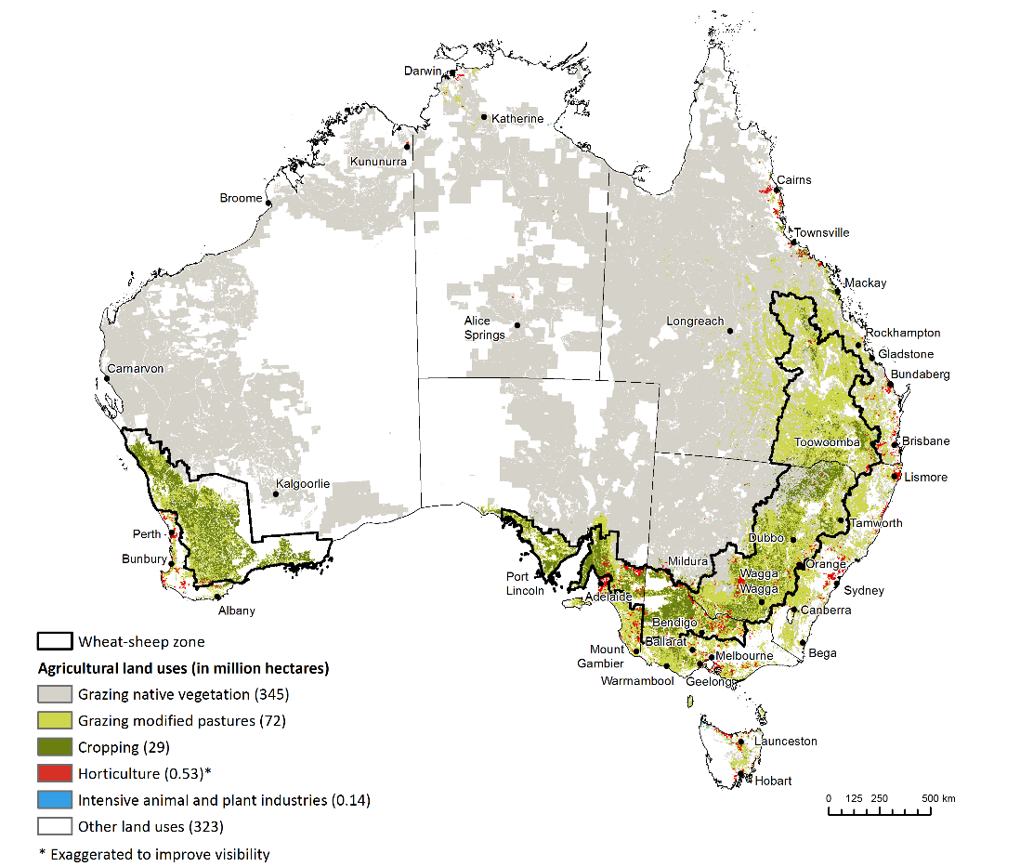
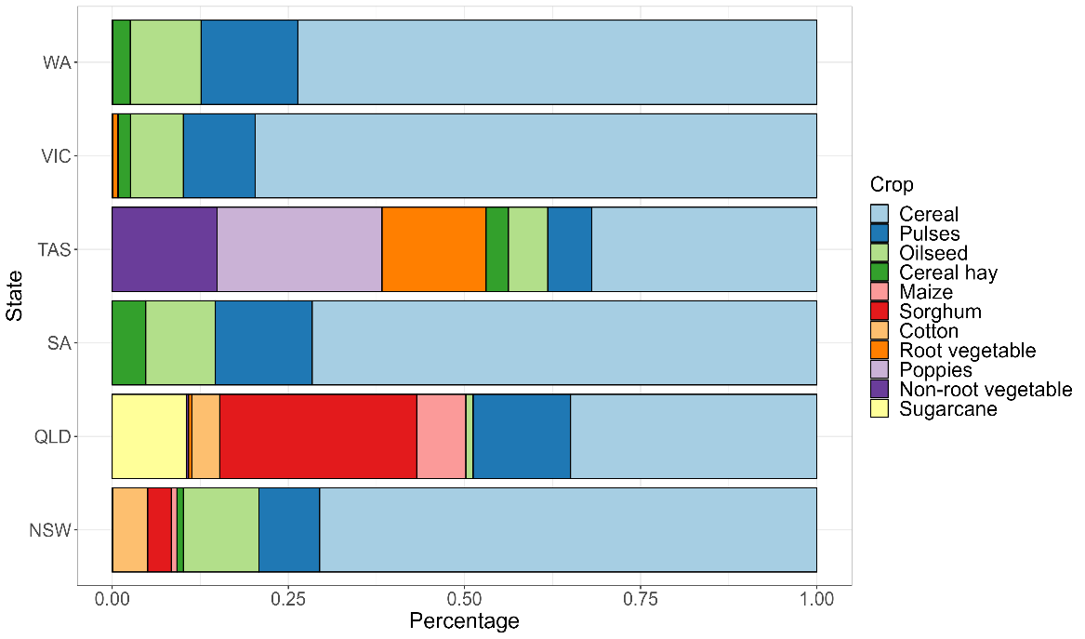
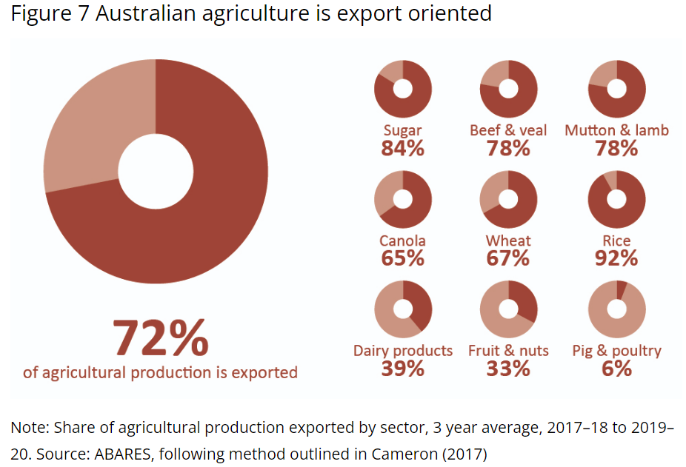
Agriculture and pasture in Australia

Slide 7
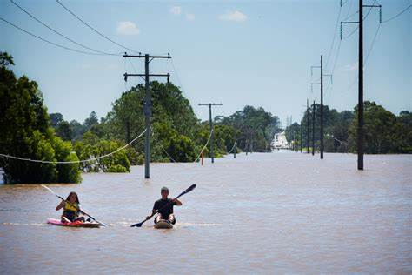
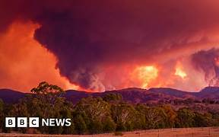
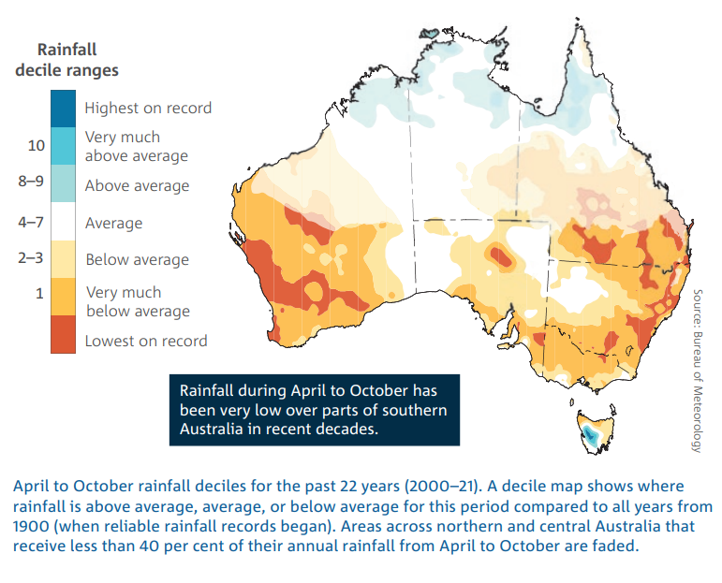
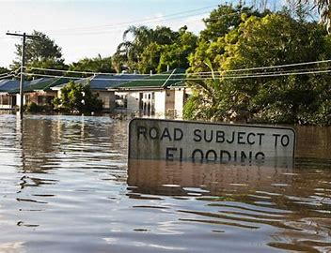
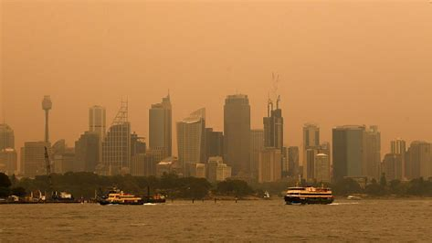
Climate issues
Byron Bay, 2020
Summer 2019, QLD
Summer 2021, QLD
Summer 2019, Sydney

Slide 8
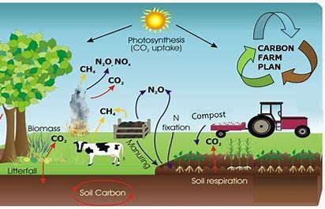
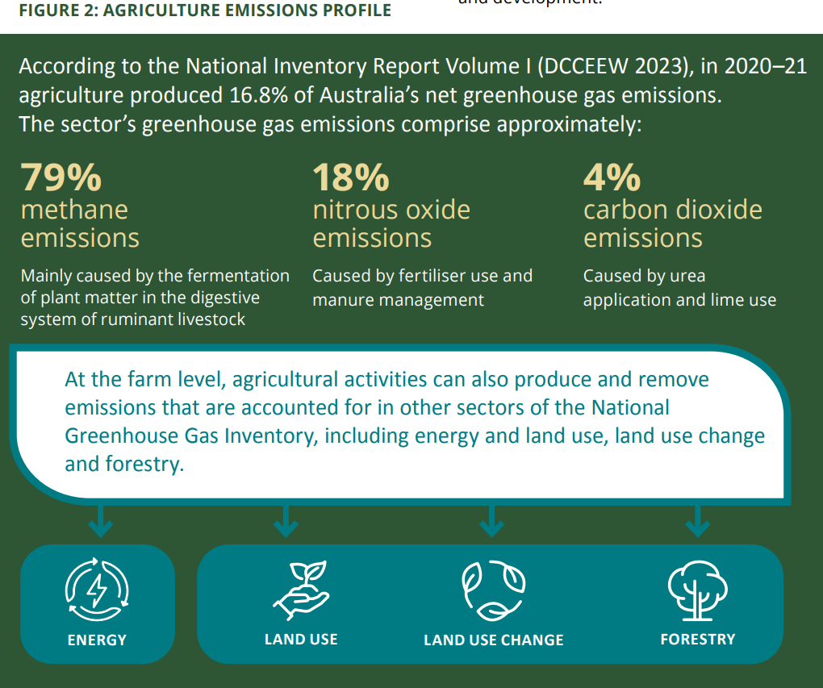
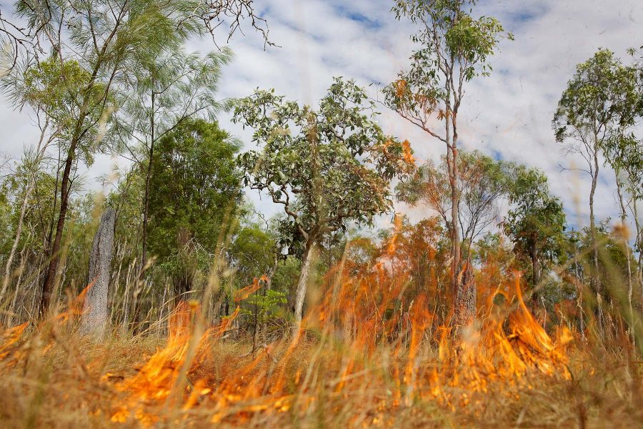
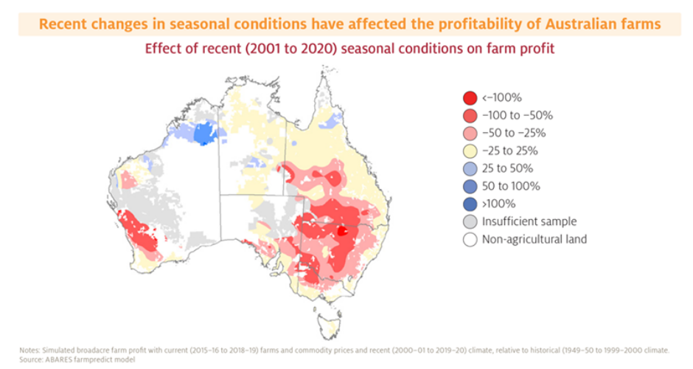
Net zero by 2050

Slide 9

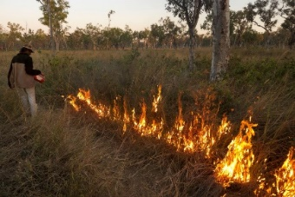

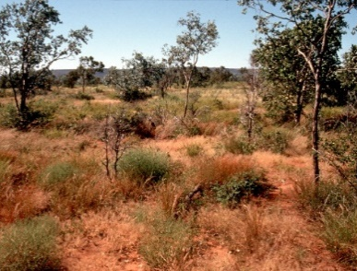
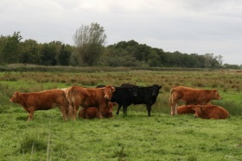


C sequestration possibility
Savanna burning
Sustainable agriculture
Research on croplands
Research on rangelands
Type of emissions
Permanency & Base line:
Regeneration project
Investment/profit/scheme
ERF-ACCUS
Cattle grazing

Slide 10
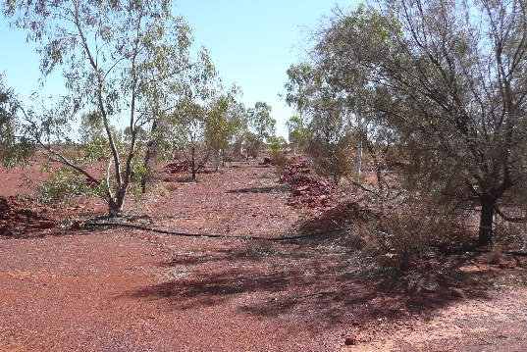
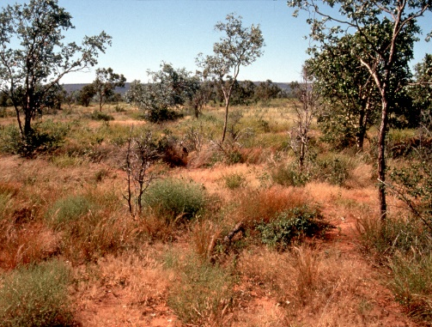
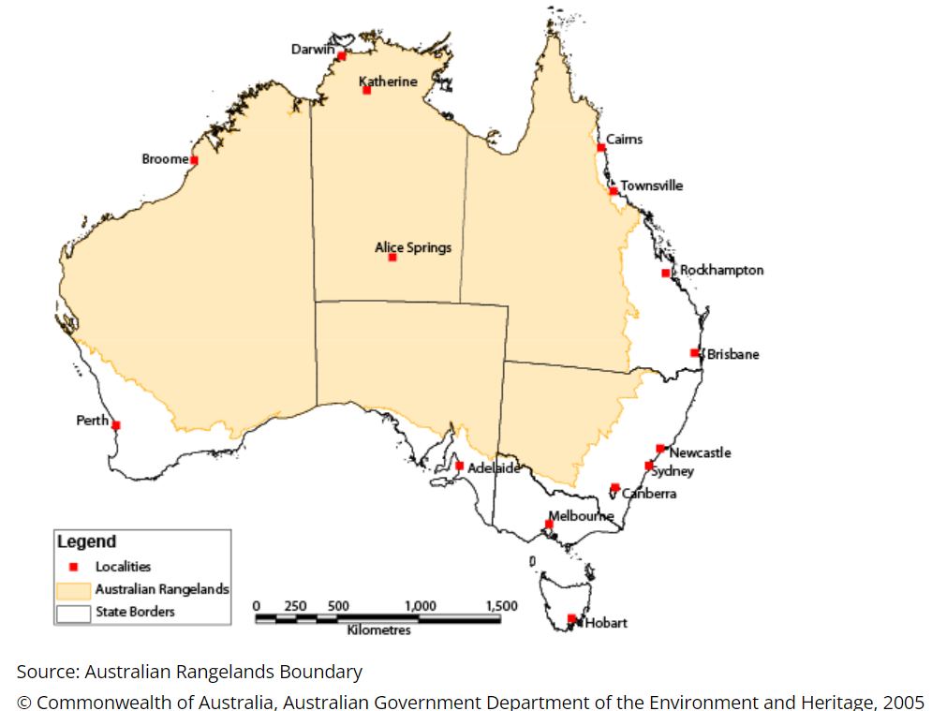
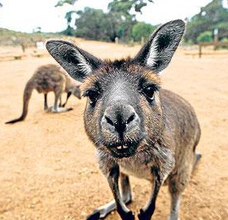
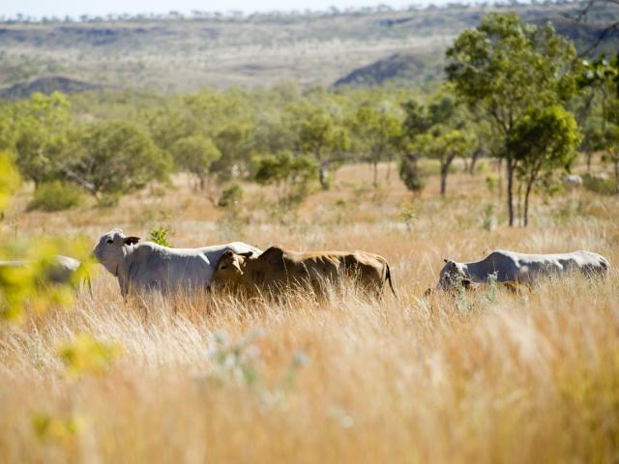

Why Rangelands?!
70% of the land!
Biosequestration possibility
Native vegetations
Wild life
Forage

Slide 11

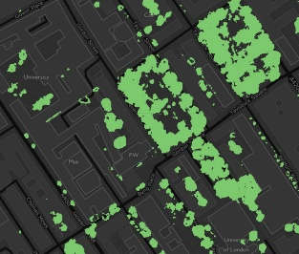



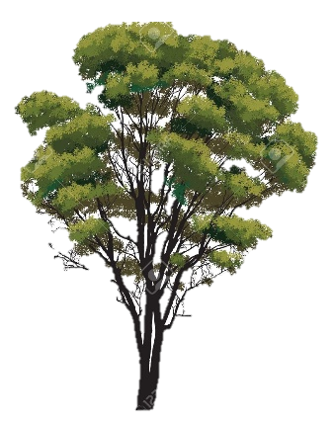


3. Spatial canopy cover product from remote sensing
Cover
What is carbon stock in Australia rangelands (set a base line)?
Cover
What are the trends over the last decade?
AG Biomass
Cover
1. Field work – Above-ground woody biomass and cover measurement
2. Calibration and validation of empirical relationships

Slide 12
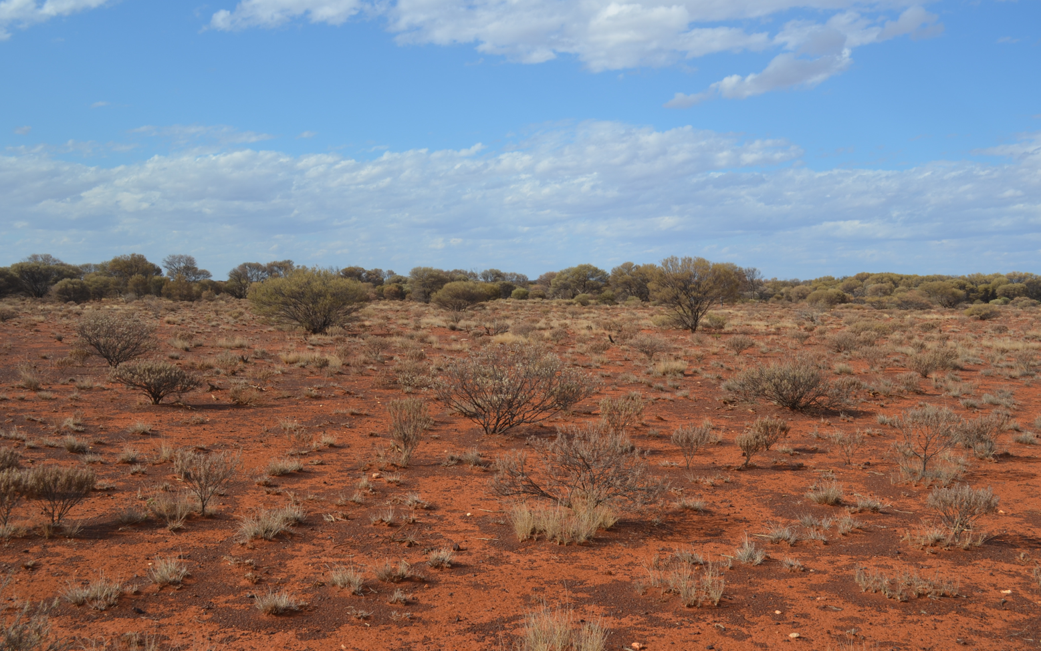
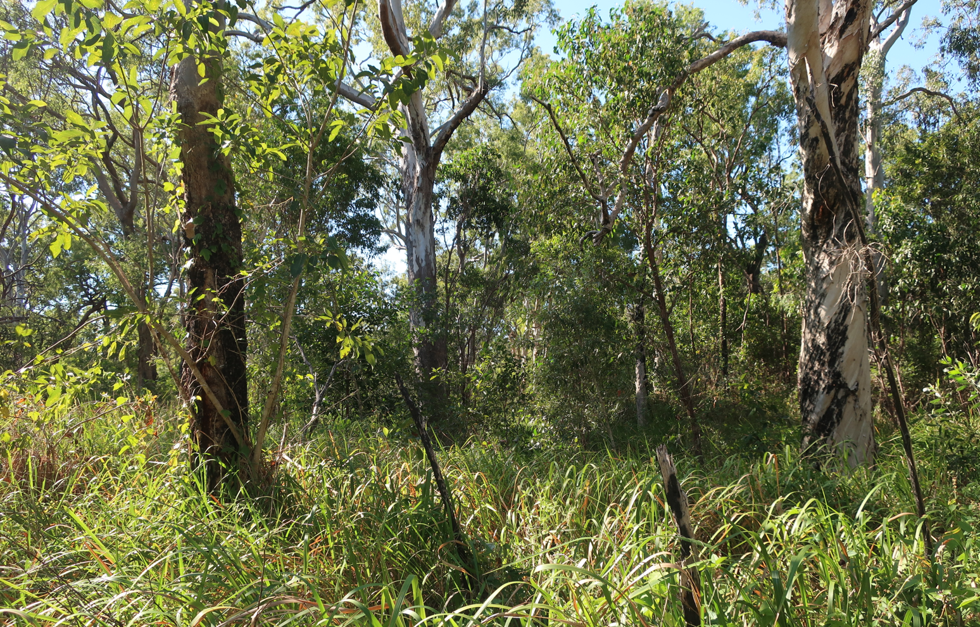
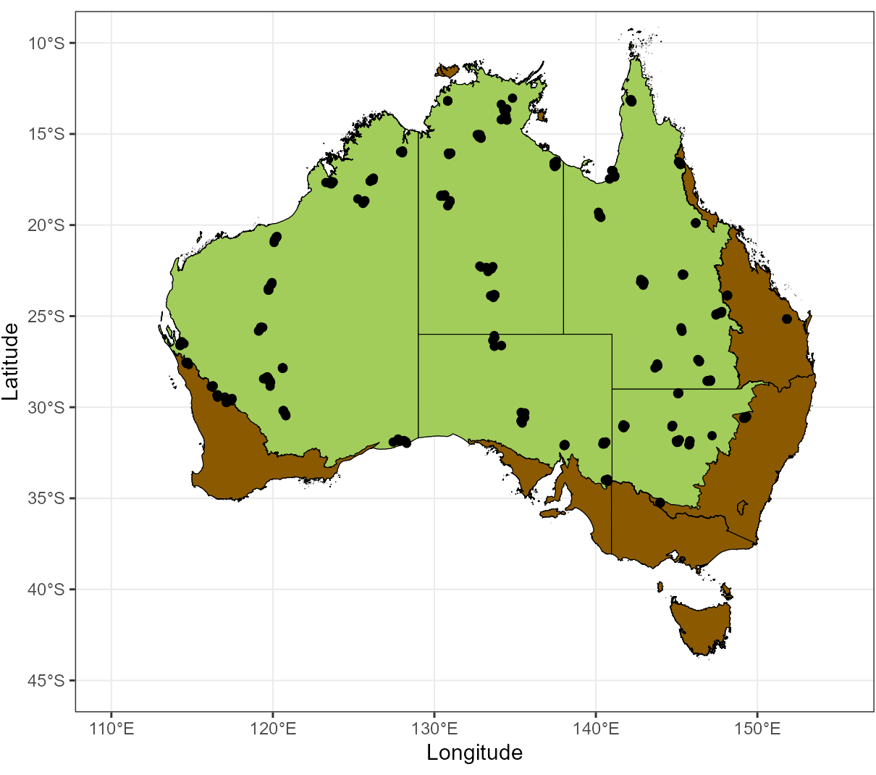
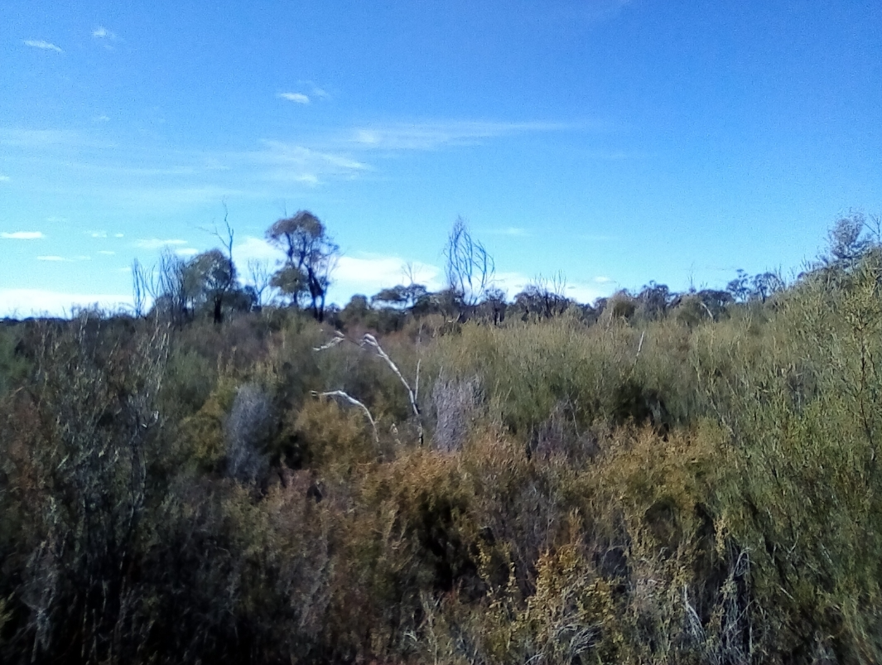
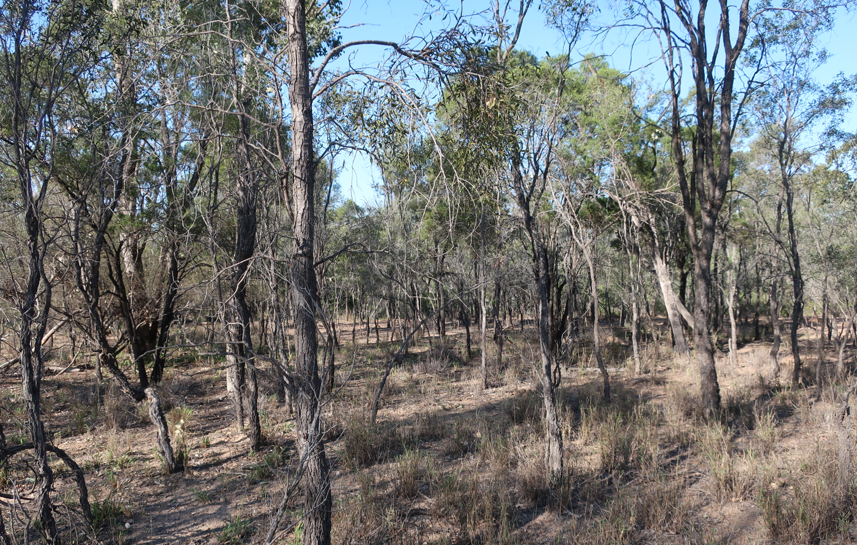
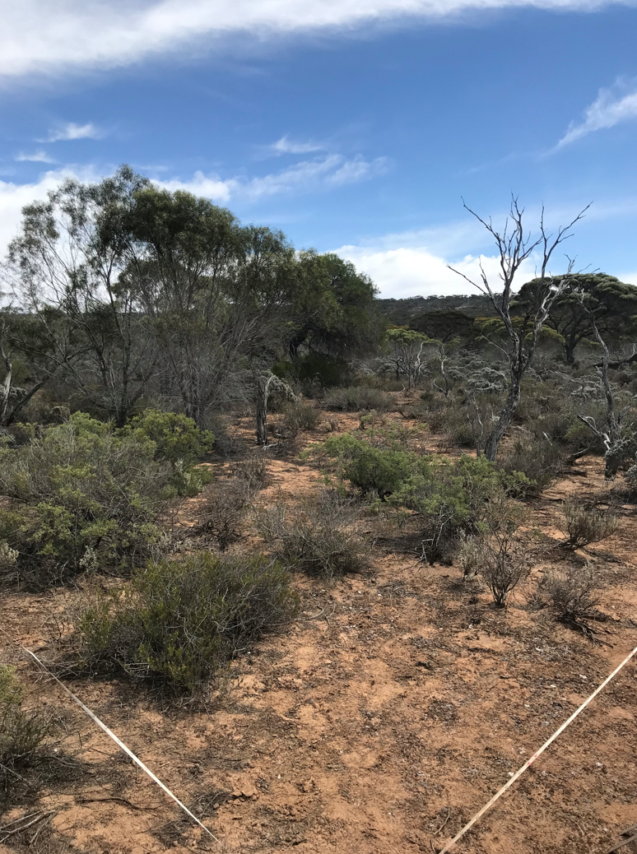
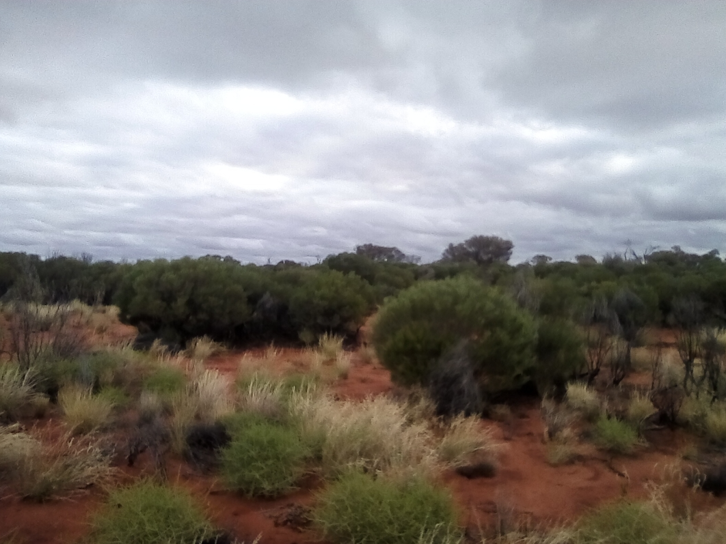
Cover to biomass component

Slide 13
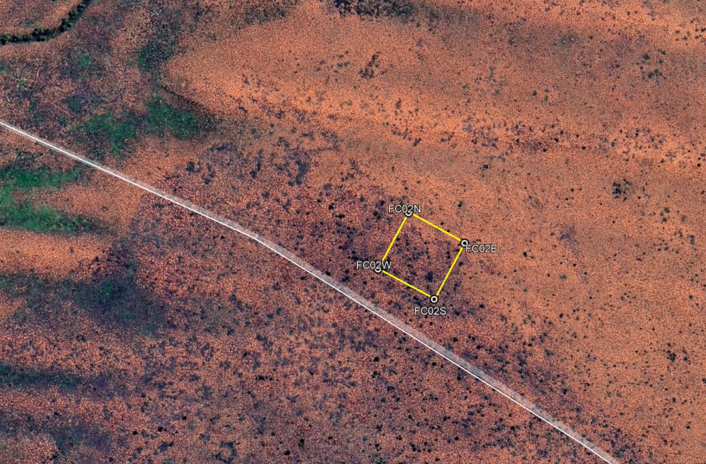
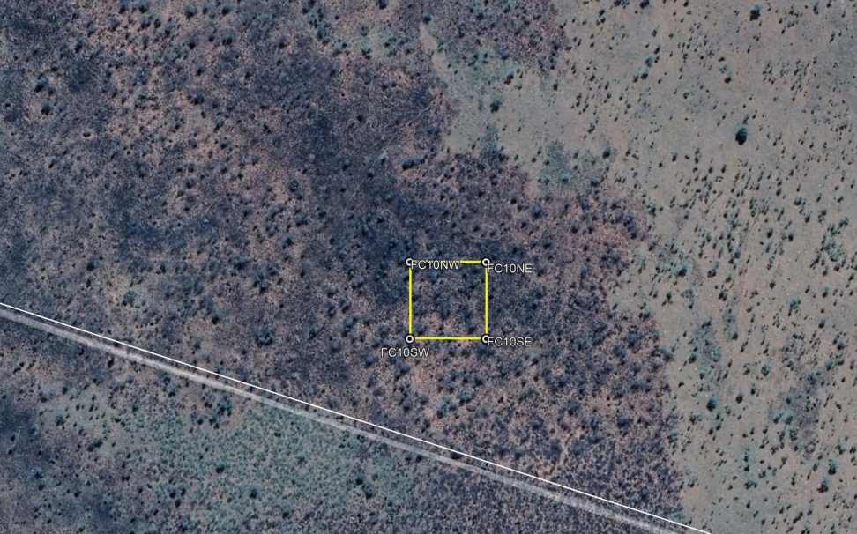
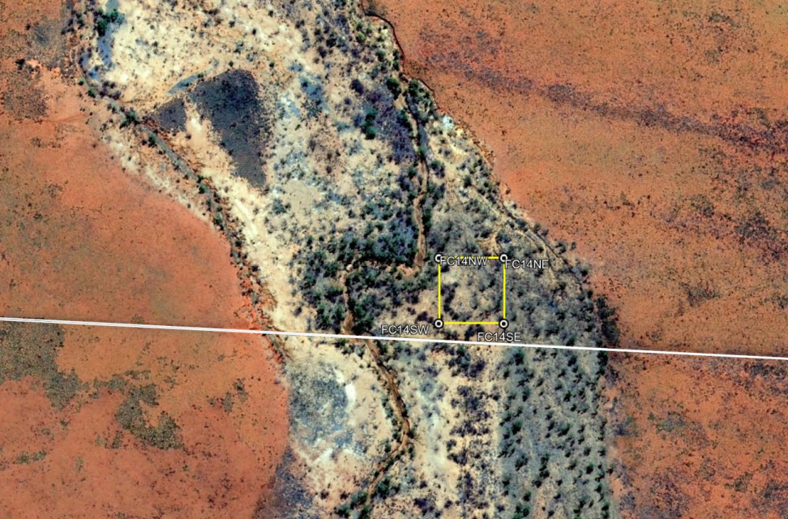
Cover to biomass component

Slide 14
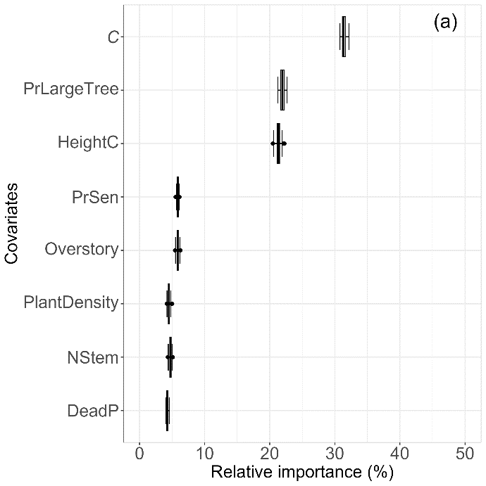
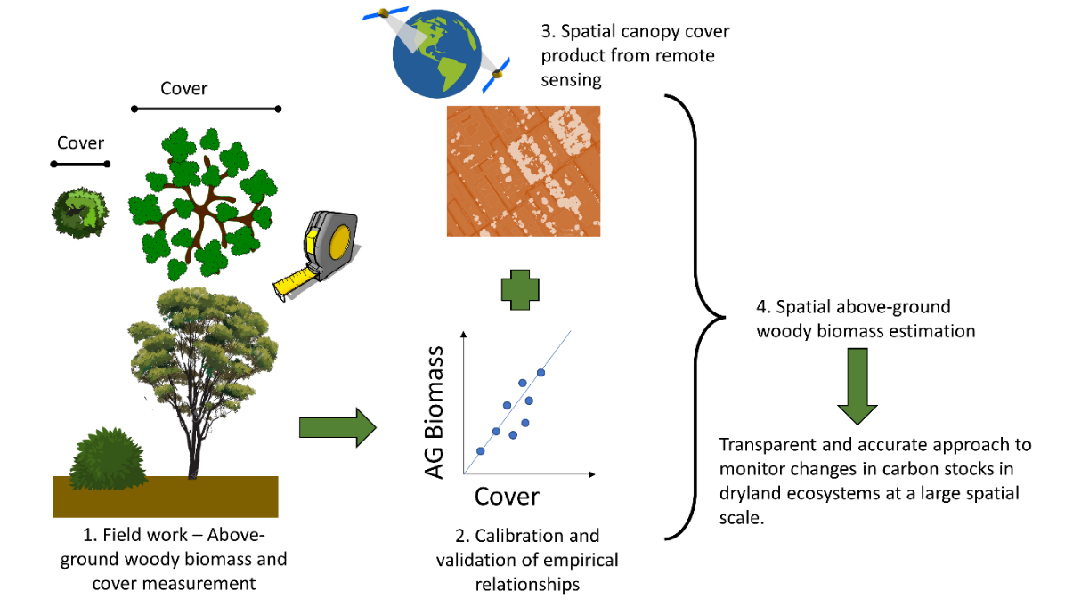
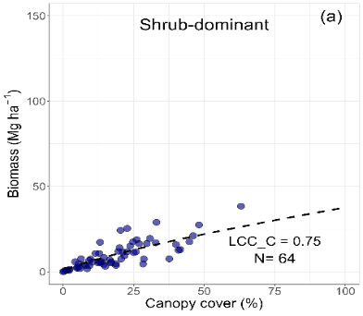
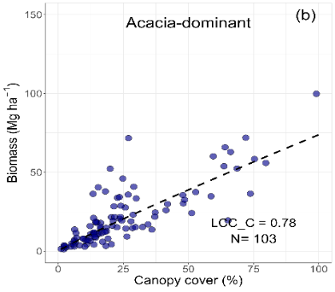
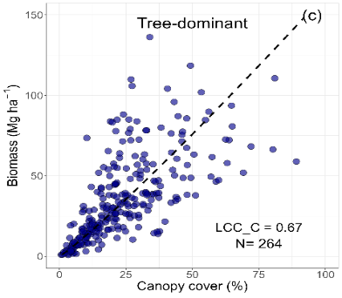
Cover to biomass component
Work in progress
Pasut et al, 2023, under review

Slide 15

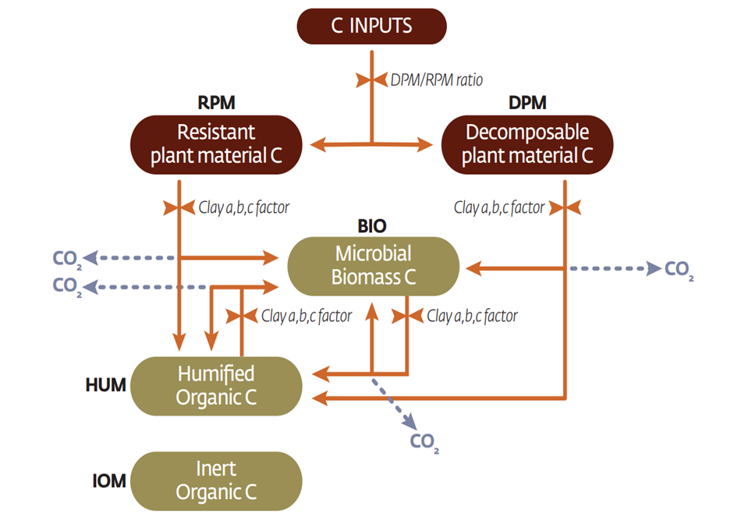
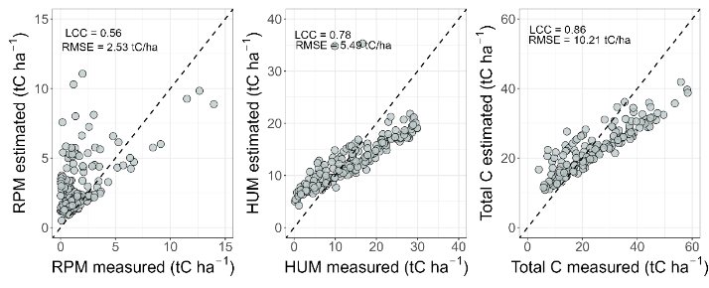
Soil component
166 Sites -> data of three fractions (ROC, POC, HOC)- one point in time
Rangelands area
TERN sites
RothC within FullCAM
Brendan, M. (2020). Soil vis-NIR spectral inference investigations of TERN Surveillance Ausplot soil specimens. CSIRO. csiro:EP2022-1831. http://hdl.handle.net/102.100.100/443968?index=1

Slide 16
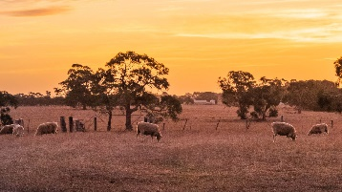
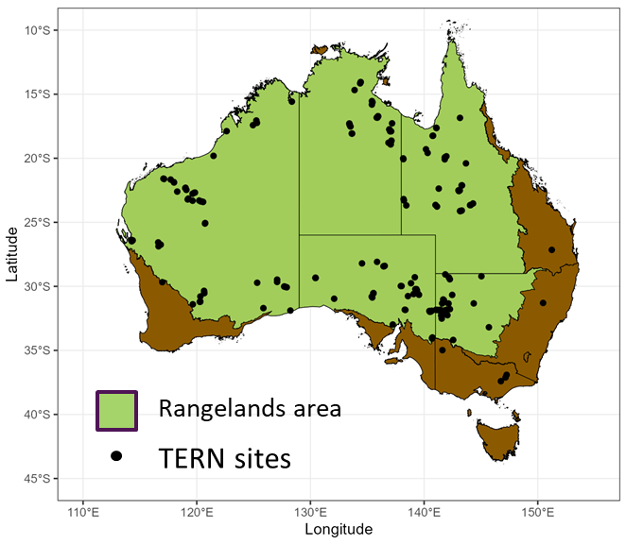



Modelling pipeline
Comprehensive Spatio-Temporal Database
Hydroclimatic variables
Soil properties
Land management
Machine Learning-like algorithm (random forest, Bayesian spatio-temporal)
No
Covariances
Meets criteria
Yes
FullCAM model
Test (25%)
Train (75%)
C stocks
C fractions
Outputs
Randomized split
Parameters’ optimisation
Ground measurements of C fractions
Uncertainty analysis
Identify and quantify the most important variables
Spatial-temporal predictions

Slide 17




Spatial-Temporal distribution of C stock
Pasut et al., 2023, MODIM 2023

Slide 18



Soil Organic Carbon-Monitoring (SOC-M) project
First sample: 3500 sites 2010

Slide 19








CSIRO-INRAe Linkage project
Compare different practices and climates to better understand how they affect changes in GHG emissions and GHG stock levels
Running CERES-EGC/APSIM

Slide 20


Thank you
Acknowledgements
Dr Senani Karunaratne
Dr Mark Farrell
Dr Brendan Malone
Dr Dan Zwartz
Dr Nick shepherd
Dr Keryn Paul
Dr Jacqui England
Dr Dan Rouser
Team of Biogeochemistry
Team of C accounting and functions

